Slide 1
Earth’s Day/Night, Year, & Seasons
How rotation, revolution, and tilt cause it all!
Notes:
Start with paper long ways
1

Slide 2
The Cause of Earth’s…
Day/Night Year Seasons
(Do not write this on your paper, these are the steps)
Fold bottom of paper up. You do not want to fold it in half. You should have about 3 cm of space to write the titles. Look on the next slide for a sample.
Title top center- “The Cause Of Earth’s…”
Write 3 titles (Day/Night, Year, Seasons) as shown.
Make a little mark at 9 and 18 cm and cut (front side only) to make doors.
Notes:
Fold bottom of paper up. You should have about 3 cm of space to write the titles.
Title top center- “The Cause Of Earth’s…”
Write 3 titles (Day/Night, Year, Seasons) as shown.
Make a little mark at 9 and 18 cm and cut (front side only) to make doors.
2

Slide 3
The Cause of Earth’s…
Day/Night
Year
Seasons
(every 9 cm)
Cut lines (top sheet only!)
Notes:
Add color
3

Slide 4
The Cause of Earth’s…
Day/Night
Year
Seasons
Rotation
Draw a picture of the Earth on its tilted axis and write the word rotation

Slide 5
The Cause of Earth’s…
Day/Night
Year
Seasons
Rotation
Include arrows to show how the Earth is rotating

Slide 6
The Cause of Earth’s…
Day/Night
Year
Seasons
define rotation
(Definition)
write down facts such as how long it lasts
(Key Statements)
In this space write an explanation on what causes day and night

Slide 7
The Cause of Earth’s…
Day/Night
Year
Seasons
Rotation
Revolution
Draw a picture of the Earth and Sun to show revolution.

Slide 8
The Cause of Earth’s…
Day/Night
Year
Seasons
Rotation
define revolution
(Definition)
(Key Statements)
Explain how long a year is and why this is the length of a year

Slide 9
The Cause of Earth’s…
Day/Night
Year
Seasons
Rotation
Revolution
Revolution + Tilt
NO!
YES!
Draw a picture that shows Earth’s tilt.

Slide 10
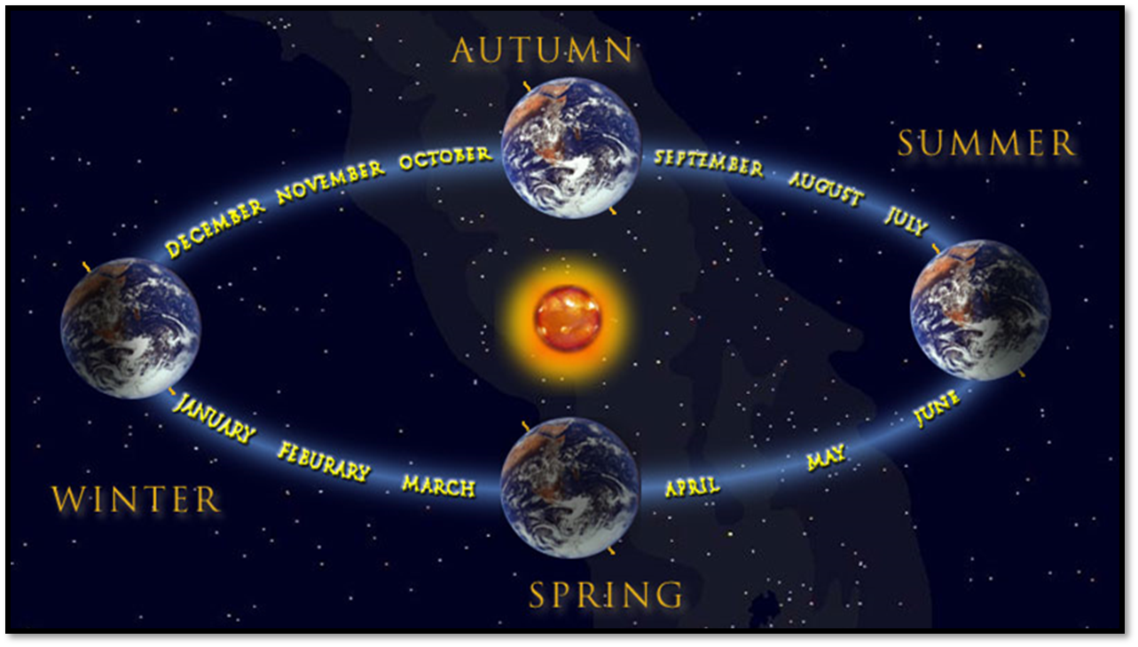
(Key Statements)
include information about equinox and solstice
The Cause of Earth’s…
Day/Night
Year
Seasons
Rotation
Revolution
What causes seasons?
Also include information about equinox and solstice.
Draw a picture of how the Earth’s tilt causes seasons

